Slide 1

Practical Data Science With Python Project on Mice Protein Level Expression By Bijo B Thomas

Slide 2
Mice Protein Expression Level
Aim of the Project:
To predict the class of the mice among the 8 types using the protein expression levels
Data Description
Data Preperation
Data Investigation and Analysis
Modelling
Conclusion

Slide 3
Data Set and its Features
A total of 82 features in the dataset
77 Numeric features of different proteins
3 categorical features namely Behaviour, Genotype and Treatment
target feature class
Genotype: controlled and trisomic
Treatment: Saline and Memantine
Behaviour: context-shock and shock-context

Slide 4
Data Preparation
Removing unwanted features
Checking for irregularities and white spaces
Imputing Missing Values
Deleting rows with excessive null values
Detecting and treating outliers

Slide 5
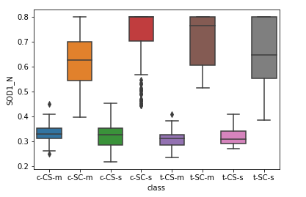
Exploring the Data
Relationship between the behaviour of the mice and the Protein ‘SOD1_N’
Behaviour
CS -> Context-Shock
SC -> Shock-Context

Slide 6
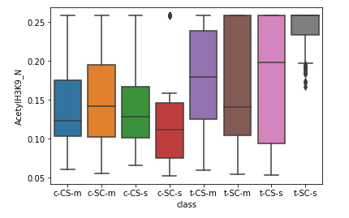
Relationship between the genotype of the mice and the Protein ‘AcetylH3K9_N’
Genotype
c -> controlled
t -> trisomic

Slide 7
Predictive Modelling
Using 2 different classifiers: KNN and Decision Tree
Splitting the data into train data and test data
Tuning the model
Feature Selection
Fitting the data into classifier with different parameters for each model
Predicting the target variable and checking the accuracy

Slide 8
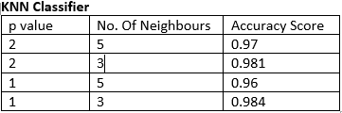
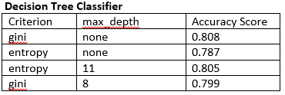
Conclusion
Once the modelling is done we chose the model with best accuracy obtained without overfitting
The accuracy of 2 different models after tuning is:

Slide 9
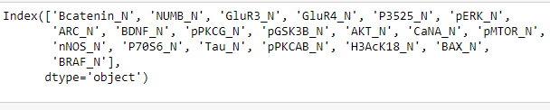
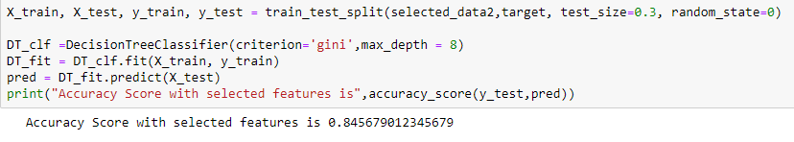
Implementing Hill climbing Technique for optimum no. of features, 20 optimum features are identified as:
And optimum accuracy for selected Decision Tree model is obtained as:
Recommendation: Presently we have just 1080 observations,more observations would greatly help the model to learn and train better.

